Slide 1
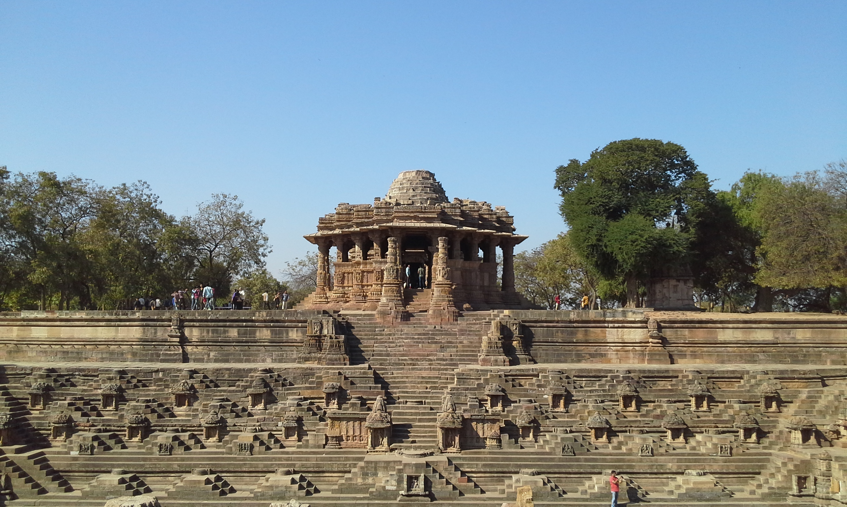
Artificial Intelligence,
Hindu Arts and Aesthetics
AI, Hindu Arts & Aesthetics
A Presentation by Dr. Vinod Vidwans

Slide 2
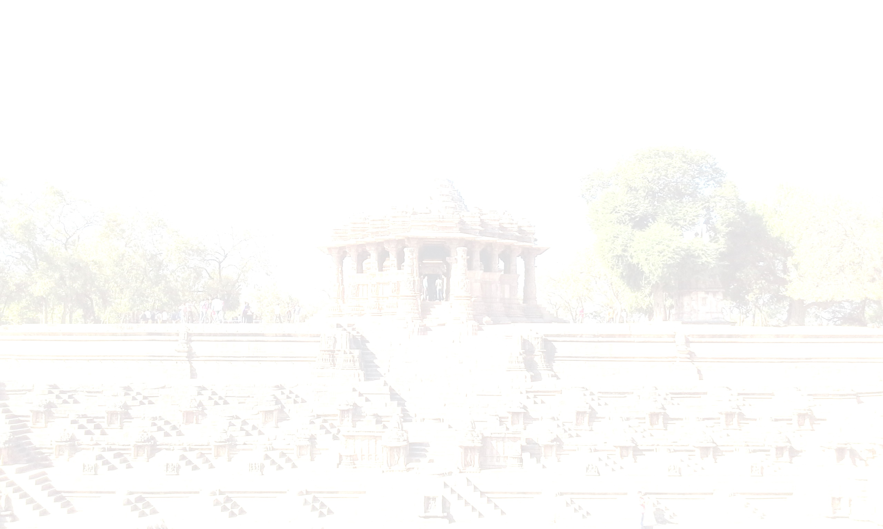
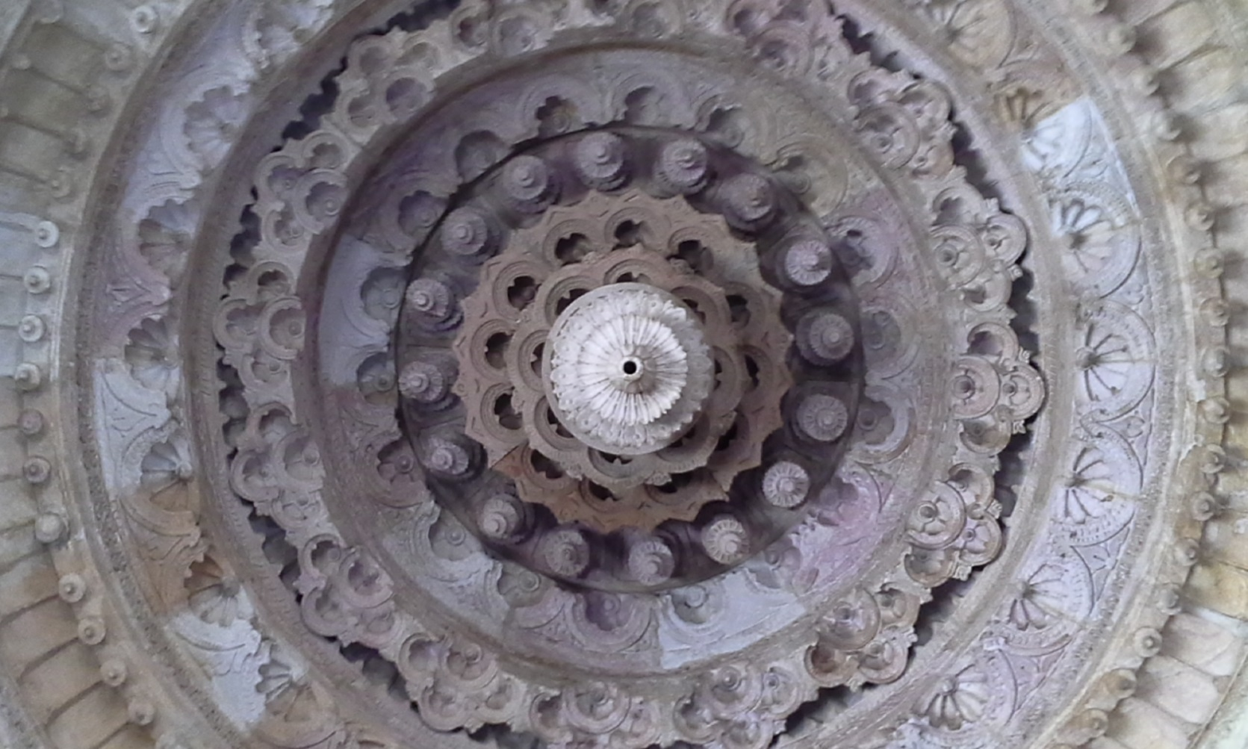
असद्वा इदमग्र आसीत्।
ततो वै सदजायत।
तदात्मान्ँ स्वयमकुरुत।
तस्मात्तत्सुकृतमुच्यत इति।
यद्वैतत्सुकृतम्।
रसो वै सः।
AI, Hindu Arts & Aesthetics
A Presentation by Dr. Vinod Vidwans
‘Non-Existence’ or ‘That’ existed then. There emerged ‘Existence’.
‘That’ created itself, and therefore, it was ‘Sukruta’
– the ‘Well-Made’. The ‘Sukruta’ is ‘Rasa’.

Slide 3
A Creation is the Creator itself.
A creator transforms his ‘Being’ into a Creation.
It is perceived as artist’s expression-
Art as ‘Self-Expression’.
AI, Hindu Arts & Aesthetics
A Presentation by Dr. Vinod Vidwans
‘Non-Existence’ or ‘That’ existed then. There emerged ‘Existence’.
‘That’ created itself, and therefore, it was ‘Sukruta’
– the ‘Well-Made’. The ‘Sukruta’ is ‘Rasa’.

Slide 4
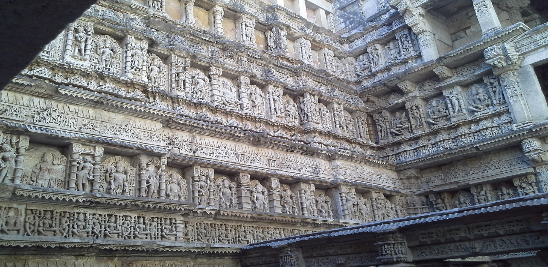
Art and Aesthetic Experience
Indian theories of art and aesthetics evolved along various Indian philosophical schools. Philosophical and core concepts were borrowed from these schools and adopted them with certain modifications.
AI, Hindu Arts & Aesthetics
A Presentation by Dr. Vinod Vidwans

Slide 5
In Vedanta, Brahman – the Ultimate Truth – represents the ‘Inner Harmony’ of the Universe.
Realization of Brahman is the realization of Universal Harmony.
A metaphysical goal of every artist is to attain this state which is direct and not mediated.
AI, Hindu Arts & Aesthetics
A Presentation by Dr. Vinod Vidwans

Slide 6
As per Vedanta, the aim of art is to create an ideal work of art by inducing an attitude of complete detachment and try to be as close as possible to the state of Brahman. Therefore, the work of art should lead the artist as well as the audience to that restful bliss, realization of that harmony. Universal harmony is realized in one’s own experience and not merely intellectually apprehended (Hiriyanna 1954: 6–10).
AI, Hindu Arts & Aesthetics
A Presentation by Dr. Vinod Vidwans

Slide 7
The ultimate objective of artistic expression is to evoke a unique kind of Aesthetic Experience- take the audience into the realm of unworldly, virtual experience.
To achieve this artist, constructs an imaginative world that is complete in itself.
A performing artist creates an imaginary world using the artistic devices of language, poetic phrases, dialogues, rhyming words, beautiful hand gestures, and body postures.
AI, Hindu Arts & Aesthetics
A Presentation by Dr. Vinod Vidwans

Slide 8
In painting, sculpture, and architecture, artists use the visual language of shapes, forms, colours, texture, positive and negative spaces to create meaningful reality.
The languages of creative expression require a grammar of aesthetics. This grammar is implicitly present and followed by artists intuitively. Artists also have their own explicit grammar or canons for the language of artistic articulation.
AI, Hindu Arts & Aesthetics
A Presentation by Dr. Vinod Vidwans

Slide 9

Art as Computation
Art is an act of creating, expressing, and making. Art is a presentation and
representation of ideas, thoughts, feelings, and experiences.
The word for art in Indian tradition is कला. It is etymologically derived from the root ‘kal’ which means counting, calculating, or computation. It also means to do, to make, to accomplish, to observe, to perceive, to recognize, or to take notice.
The word ‘कल्’ thus covers larger set of activities. Artistic activity involves creative perception and calculation for visualization and articulation respectively. This etymological meaning of the word ‘कल्’ i.e., to calculate or measure led to further exposition and development of quantitative standards for artistic practices in India.
AI, Hindu Arts & Aesthetics
A Presentation by Dr. Vinod Vidwans

Slide 10
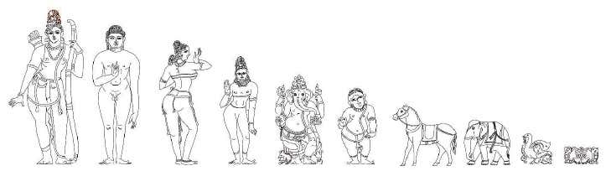
Especially in the field of visual and performing arts, calculative and computational aspect of arts got elaborate exposition. Indian arts, known for their spiritual and metaphysical content are very much quantitative in their material and physical manifestations. All this is aimed at achieving that ‘Universal Harmony’
It is fascinating to see that all the theoretical concepts of Indian arts have quantitative or computational components. It is beyond the scope of this paper to give elaborate exposition to all the concepts from a computational point of view.
Many of us are familiar with the idea of Tala-Mana Pramana ratios used in Shilpa Shastra. Similarly, all the Indian art forms have their own domain-specific measurement systems and computational grammars.
AI, Hindu Arts & Aesthetics
A Presentation by Dr. Vinod Vidwans

Slide 11
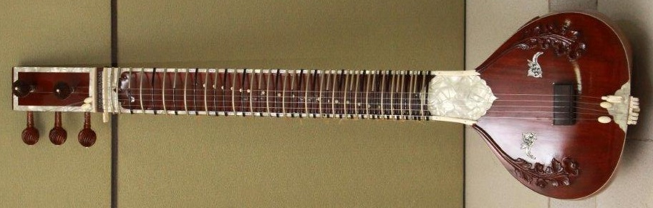
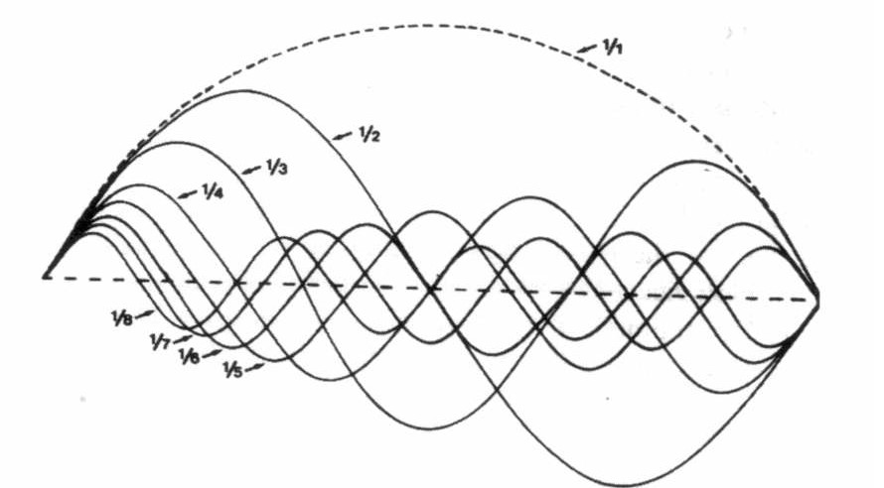
Indian arts and quantification go hand in hand. Artistic creations have profound computational foundations in Indian arts.
It does not destroy the quality of aesthetic experience, on the other hand, it facilitates the process of attaining the ‘Universal Harmony’. There exists a correlation between artistic computation and the aesthetic experience.
It is fascinating to see that underneath the evocative ability of music there are quantitative and computational principles of ‘Musical Grammar’ that make this aesthetic experience possible.
It is interesting to see how computational principles of Indian music play an active role and contribute in generation of music.
AI, Hindu Arts & Aesthetics
A Presentation by Dr. Vinod Vidwans

Slide 12
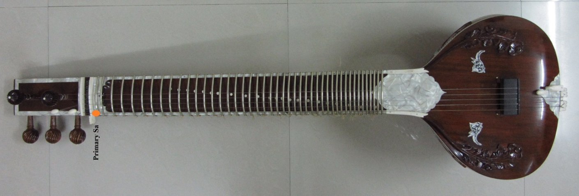
From the base swara or Adhar Swara by application of rules mentioned in Natyashastra it is possible to demonstrate that entire domain of music can be established.
Here it is shown that how calculation and computation leads to generation of Shrutis and Swaras of Indian music.
Consequently, computable relationships between and among swaras lead to generation of Jatis, Moorchchhanas, Taanas and eventually- Ragas.
This can be demonstrated on specially designed Veena called ‘Bharat Veena’
Bharat Veena
AI, Hindu Arts & Aesthetics
A Presentation by Dr. Vinod Vidwans

Slide 13
Bharat Veena is Designed and Developed based on the description from Bharata’s Natyashastra and Sangita Ratnakara of Sharangadeva
Bharat Veena is capable of demonstrating the ancient Musical theoretical concepts such as Shruti Nidarshanam Experiment from Bharata’s Natyashastra. This Experiment is also known as `Sarana-Chatushtayi Prayoga’. It can be performed on the Bharat Veena.
Bharat Veena has dedicated Strings for Shadja Grama, Madhyama Grama and Gandhara Grama each.
Gramantara Experiment also can be demonstrated on Bharat Veena.
Bharat Veena
AI, Hindu Arts & Aesthetics
A Presentation by Dr. Vinod Vidwans

Slide 14
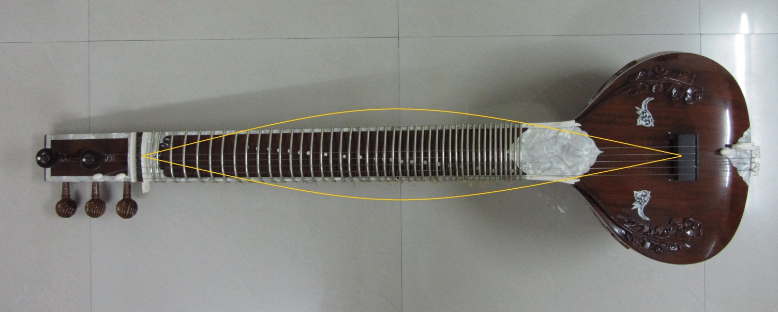
Swara-Sthapana & Shruti Generation
The entire length of the string of a Bharat Veen produces the natural
Sa (Shadja) swara.
व्यवहारे त्वसौ त्रेधा हृदि मन्द्रोऽभिधीयते|
कण्ठे मध्यो मूर्ध्नि तारो द्विगुणश्चोत्तर:||
[Sangita Ratnakar 1-3-7]
AI, Hindu Arts & Aesthetics
A Presentation by Dr. Vinod Vidwans

Slide 15
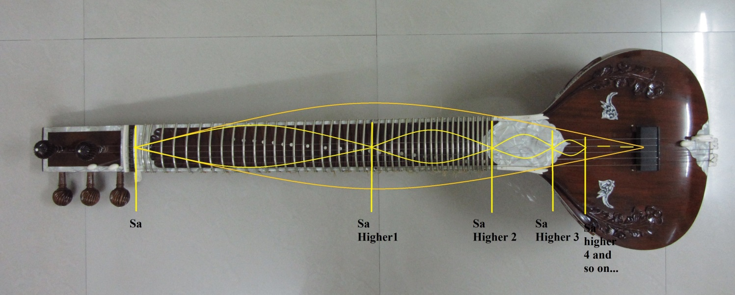
Swara-Sthapana & Shruti Generation
Higher Shadja swara is located exactly on the mid-point of the Veena.
The higher Saptakas are established by following same Gunottara Pramana.
व्यवहारे त्वसौ त्रेधा हृदि मन्द्रोऽभिधीयते|
कण्ठे मध्यो मूर्ध्नि तारो द्विगुणश्चोत्तर:||
[Sangita Ratnakar 1-3-7]
AI, Hindu Arts & Aesthetics
A Presentation by Dr. Vinod Vidwans

Slide 16
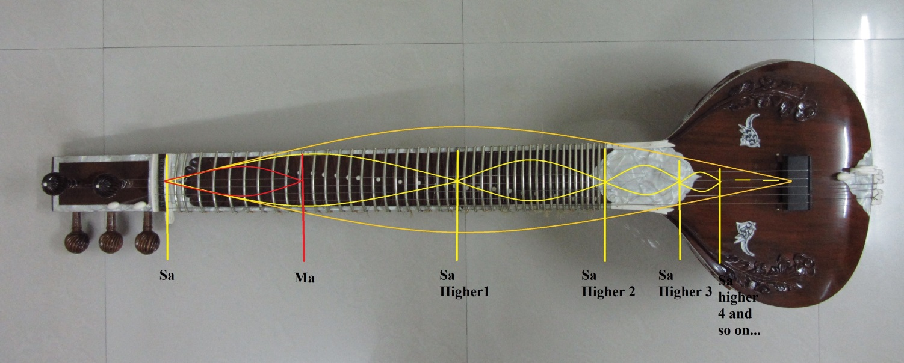
Swara-Sthapana & Shruti Generation
Madhyama swara is exactly on the mid-point between Shadja and the higher
Shadja swaras. That is the reason it is called `Madhyama’ swara. It is a
Harmonic Mean of Shadja & Higher Shadja
AI, Hindu Arts & Aesthetics
A Presentation by Dr. Vinod Vidwans

Slide 17
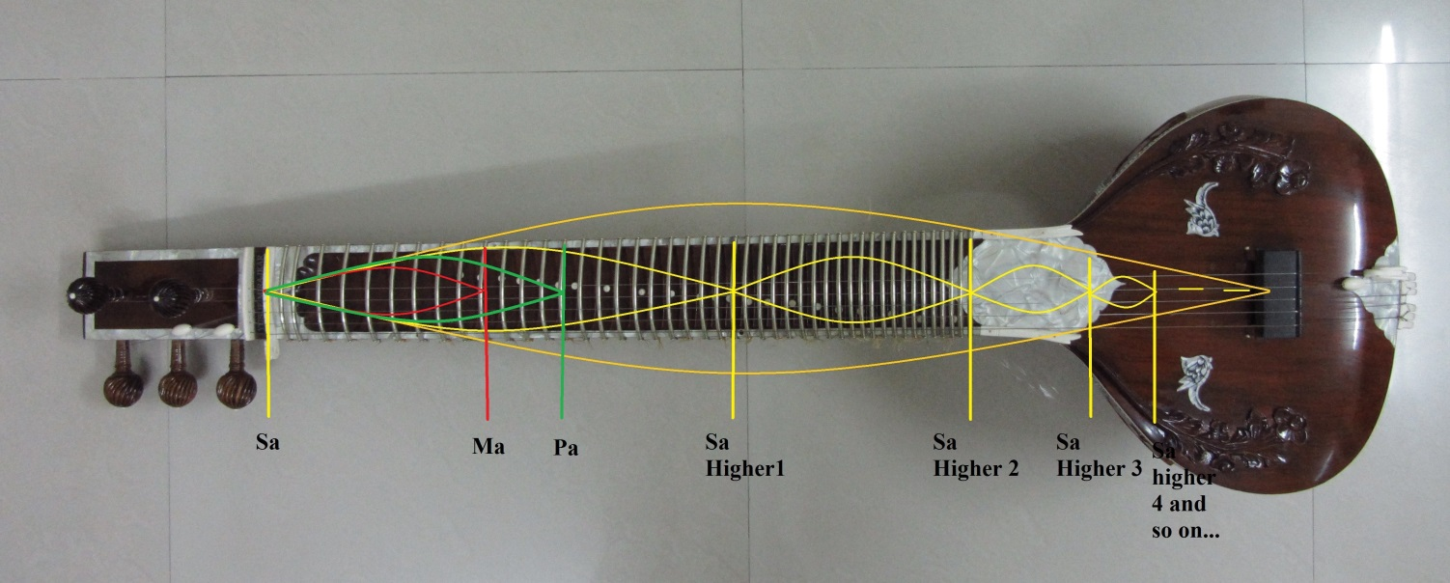
Swara-Sthapana & Shruti Generation
The Panchama swara is located on the point having the ratio 2/3 between
Shadja and the Higher Shadja swaras. Panchama is the Arithmetic Mean of
Shadja and Higher Shadja
AI, Hindu Arts & Aesthetics
A Presentation by Dr. Vinod Vidwans

Slide 18
Swara-Sthapana & Shruti Generation
Shadja, Madhyama and Panchama give birth to remaining Swaras and Shrutis. This method is called `Chakriya Nyaya’
Sa-Ma ratio is known as Shadja-Madhyama Bhava
Sa-Pa ratio is known as Shadja-Panchama Bhava
According to Natyashastra
AI, Hindu Arts & Aesthetics
A Presentation by Dr. Vinod Vidwans

Slide 19
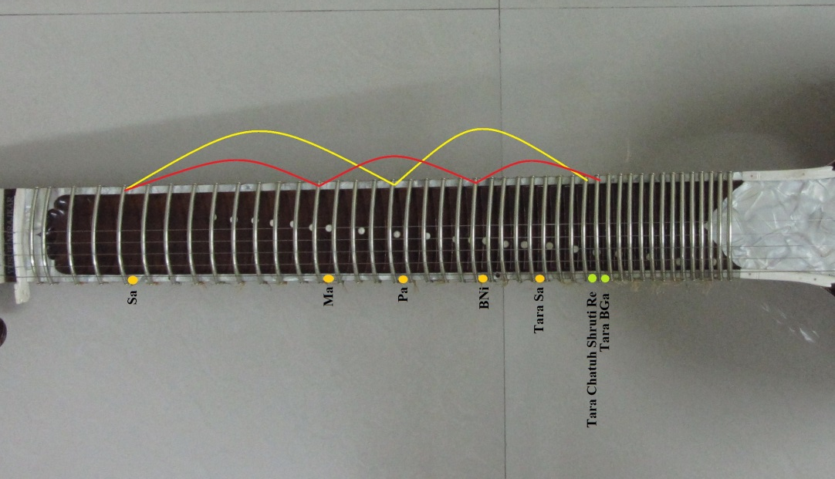
All the seven swaras and twenty two shrutis can be generated
by Chakriya Nyaya Method as follows
Shadja-Madhyama Bhava (Cycle of Fourth)
Shadja-Panchama Bhava (Cycle of Fifth)
AI, Hindu Arts & Aesthetics
A Presentation by Dr. Vinod Vidwans

Slide 20
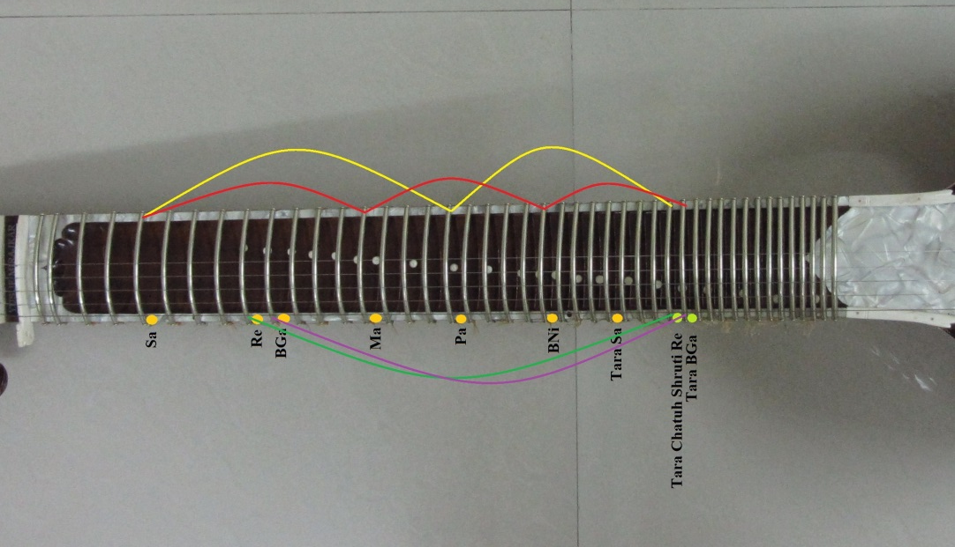
This method is also called `Swara-Mandala Sadhanam’
अथद्वौ ग्रामौ षड्जग्रामो मध्यमग्रामश्चेति|
अत्राश्रिता द्वाविंशतिश्रुतयः स्वरमण्डलसाधिताः|
[Bharata’s Natyashastra]
AI, Hindu Arts & Aesthetics
A Presentation by Dr. Vinod Vidwans

Slide 21
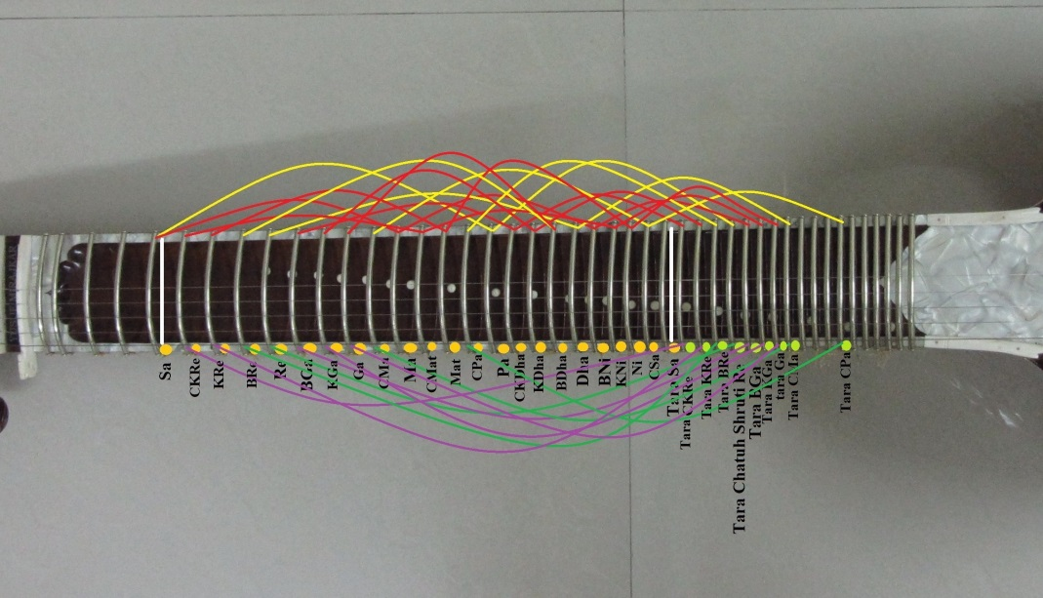
`Swara-Mandala Sadhanam’
तत एव स्थानान्तरे स्वरमंडलत्वमिति चक्रमुच्यते|
तच्च परिमंडलं आंगिरसकाश्यपादिभिः मुनिभिः दर्शितम् |
[Abhinavagupta in Bharata, p. 19].
AI, Hindu Arts & Aesthetics
A Presentation by Dr. Vinod Vidwans

Slide 22
`Swara-Mandala Sadhanam’
This Method was known to the ancient sages such as Aangirasa and Kashyapa. Abhinava Gupta has described this method in his commentary on
Bharata’s Natyashastra.
AI, Hindu Arts & Aesthetics
A Presentation by Dr. Vinod Vidwans

Slide 23
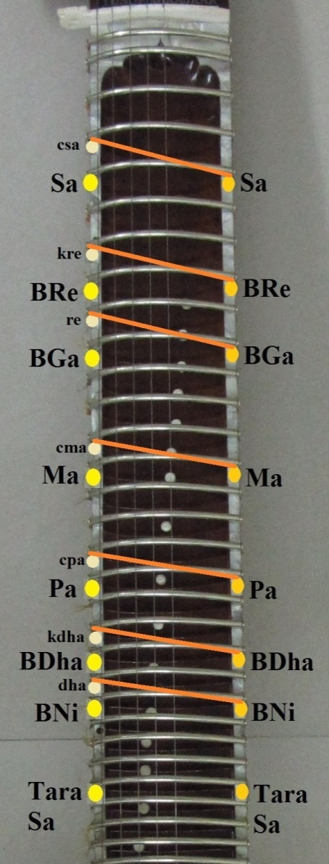
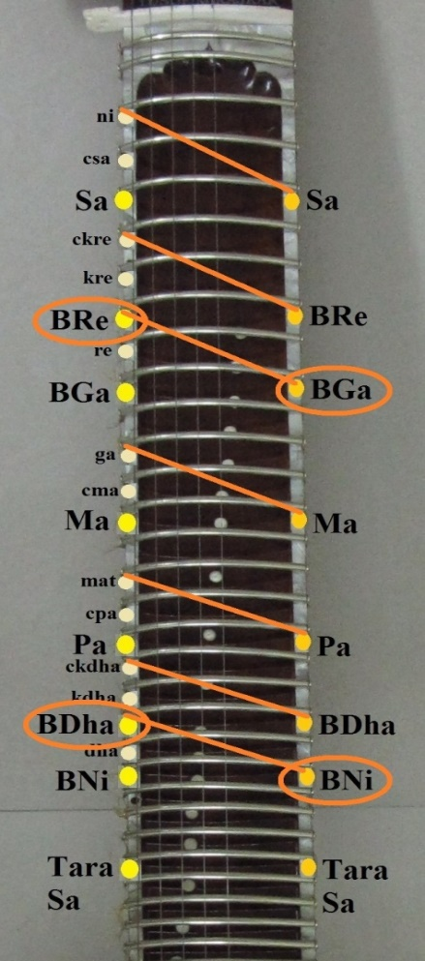
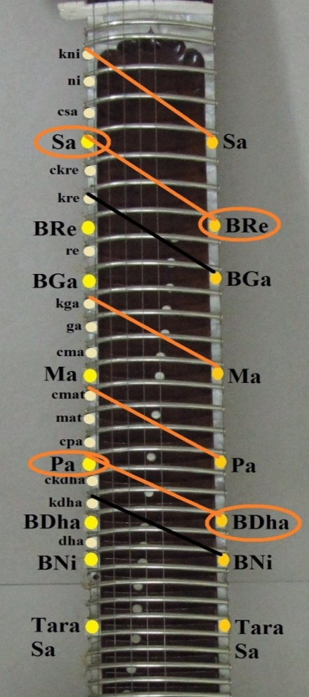
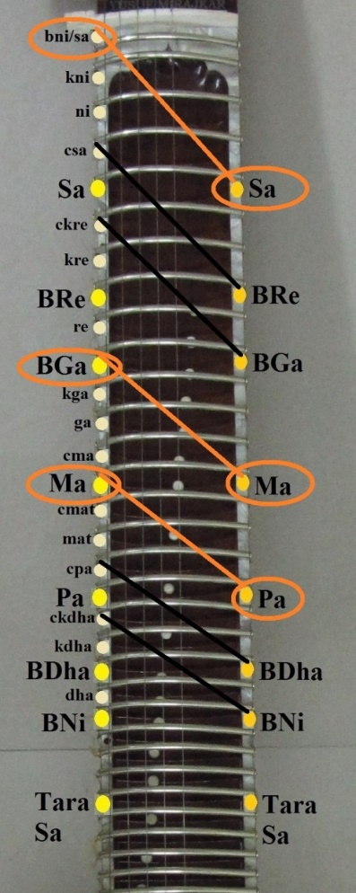
`Shruti-Nidarshanam’
After establishing shrutis, the Shruti-Nidarshanam experiment from Bharata’s Natyashastra can be performed on the Bharat Veena
First Sarana
Second Sarana
Third Sarana
Fourth Saarana
AI, Hindu Arts & Aesthetics
A Presentation by Dr. Vinod Vidwans

Slide 24
`Swara-Samvada’
Shruti Nidarshanam demonstrates Samvad Bhavas among swaras such as
Sa-Pa, Sa-Ma, BRe-BDha, Bga-Bni, Re-Dha, Ga,Ni and so on…
This experiment provides empirical and experimental basis for
Samvadi Swaras, Vivadi Swaras and Anuvadi Swaras
AI, Hindu Arts & Aesthetics
A Presentation by Dr. Vinod Vidwans

Slide 25
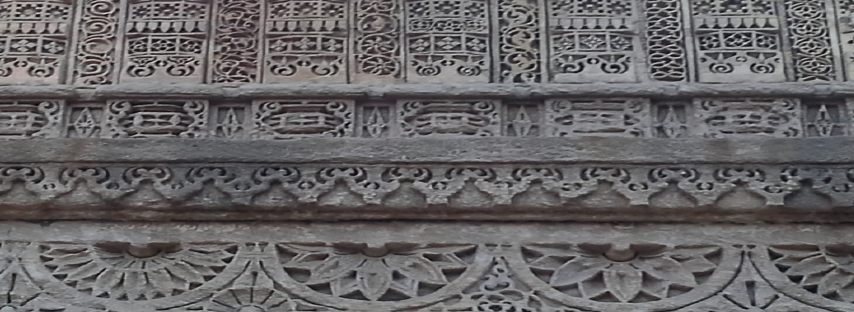
Indian Art and Computational Aesthetics
Shruti, Swaras, Samvad-Bhavas between and among swaras lead to
many more musical concepts such as Jatis, Moorchchhanas, and Taanas.
Ancient music was different from contemporary music.
However, these concepts eventually evolved into the system of Ragas.
This discussion indicates that artistic expressions can be understood
as computations. Using computational algorithms artists can explore
new structures, leading to new forms of
cultural significance.
AI, Hindu Arts & Aesthetics
A Presentation by Dr. Vinod Vidwans

Slide 26
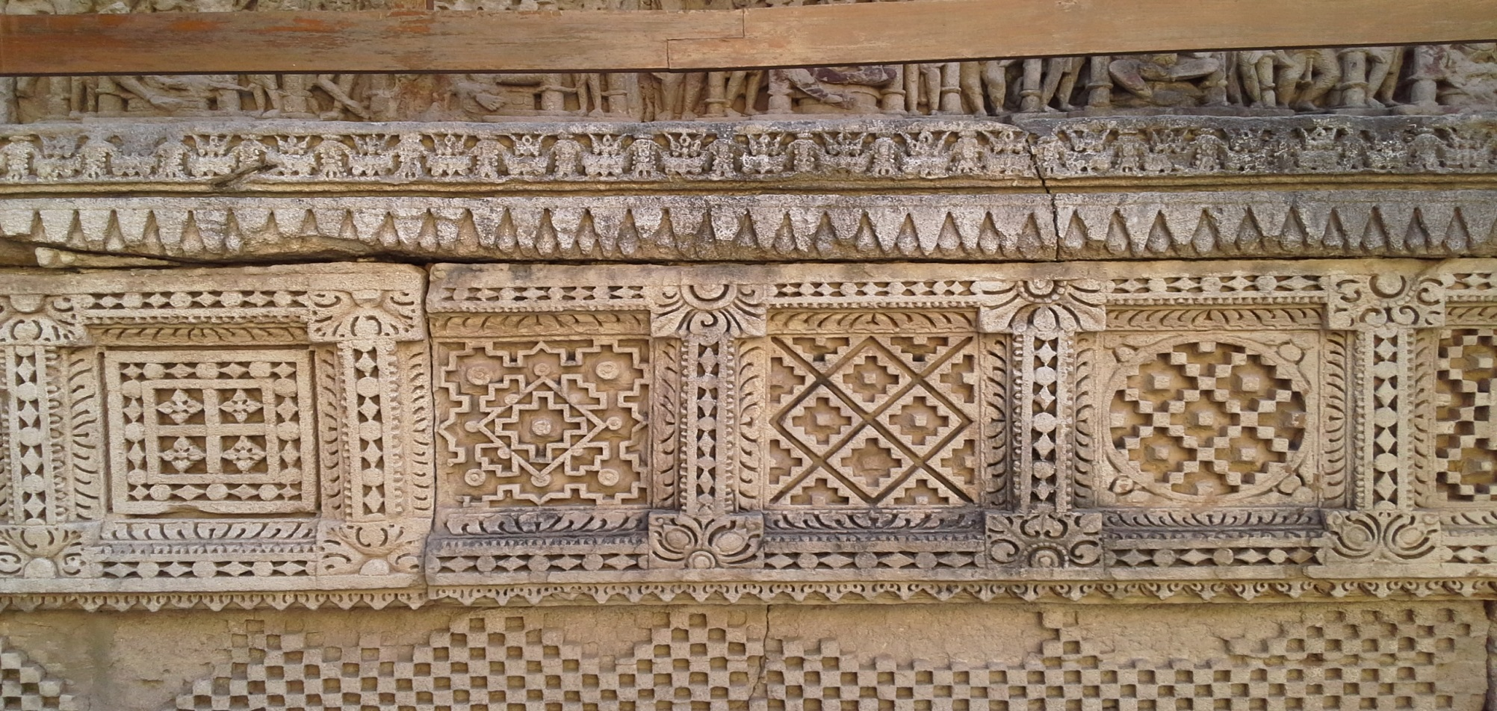
New Aesthetics for a New Age
Hindu Arts inherit computational foundations
Therefore, in this Digital Age
there is an opportunity for artists to see
new genres of art practices,
new aesthetics, new forms of representations,
and a whole new artistic creativity.
Computational Music for instance…
…Indian Artificial Intelligence Music
AI, Hindu Arts & Aesthetics
A Presentation by Dr. Vinod Vidwans

Slide 27
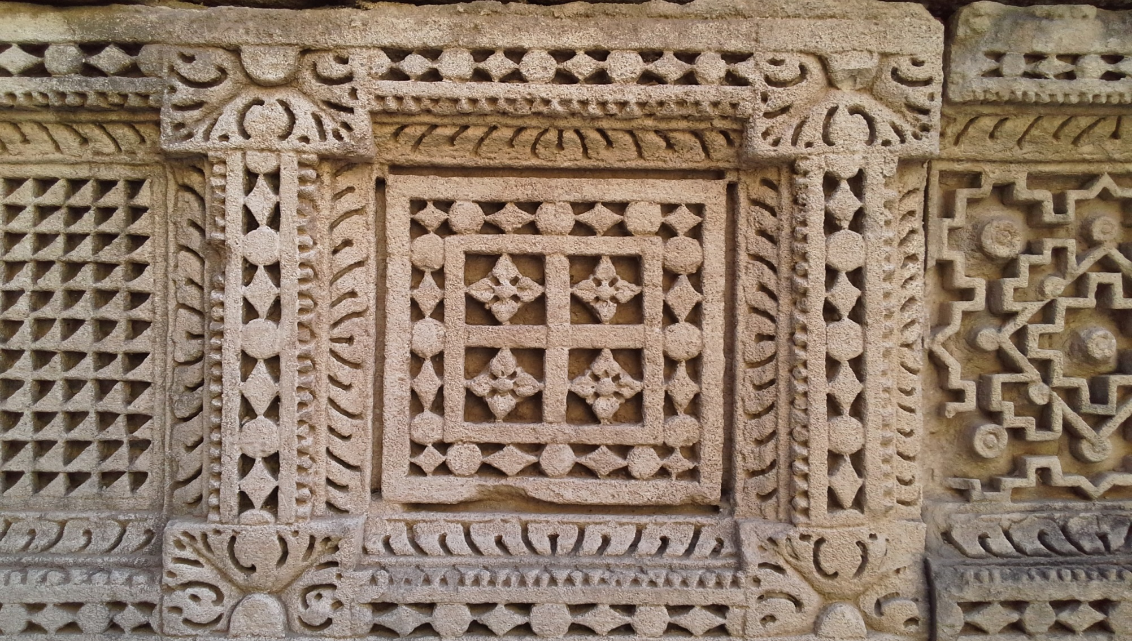
Indian AI Music
Demonstration of the Creative
Artificial Intelligence (AI) System
for Indian Music
By
Dr. Vinod Vidwans
AI, Hindu Arts & Aesthetics
A Presentation by Dr. Vinod Vidwans

Slide 28
AI, Hindu Arts & Aesthetics
A Presentation by Dr. Vinod Vidwans
ॐ तत्सत्..!

Slide 29
AI, Hindu Arts & Aesthetics
A Presentation by Dr. Vinod Vidwans
Thanks

