Slide 1
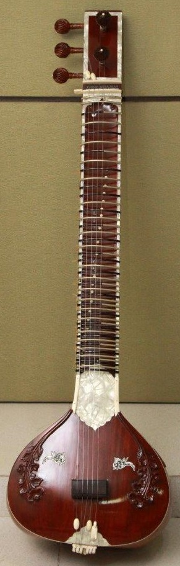
BHARAT VEENA:
A SYNTHESIS OF PHYSICS, MUSIC AND AESTHETICS
- A Presentation by Dr. Vinod Vidwans

Slide 2
BHARAT VEENA:
A SYNTHESIS OF PHYSICS, MUSIC AND AESTHETICS
Bharat Veena is a new musical instrument
based on the 2000 years old theory of
Shruti (Microtones) from Bharata’s
Natyashastra and Sangita Ratnakara of
Sharangadeva
It has dedicated 22 frets for 22 Shrutis
(microtones) in each Saptaka.
- A Presentation by Dr. Vinod Vidwans

Slide 3
BHARAT VEENA:
A SYNTHESIS OF PHYSICS, MUSIC AND AESTHETICS
This presentation aims to demonstrate
ancient Indian musical concepts and
brings forth the scientific basis of it.
It will unfold the relationship between
physics and music.
We will witness the resultant Aesthetic
beauty of the symbiotic relationship
between these two profound domains.
- A Presentation by Dr. Vinod Vidwans

Slide 4
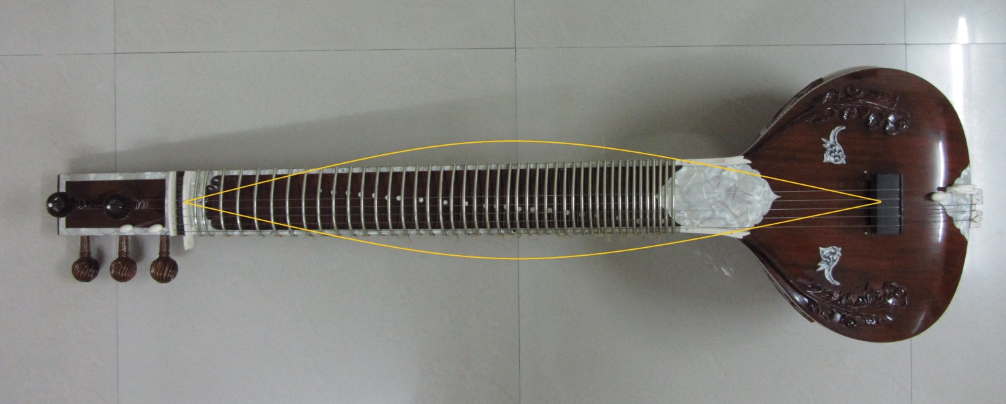
BHARAT VEENA:
A SYNTHESIS OF PHYSICS, MUSIC AND AESTHETICS
Why there are only Seven Swaras
and Twenty Two Shrutis?
The entire length of a string produces
the natural Shadja swara of a Veena
- A Presentation by Dr. Vinod Vidwans

Slide 5
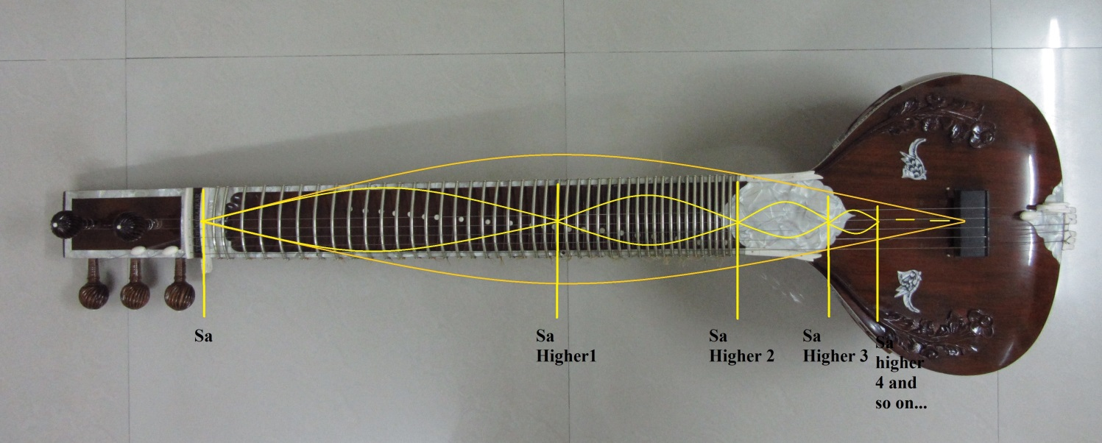
BHARAT VEENA:
A SYNTHESIS OF PHYSICS, MUSIC AND AESTHETICS
Higher Shadja swara is located exactly on
the mid-point of the Veena
व्यवहारे त्वसौ त्रेधा हृदि मन्द्रोऽभिधीयते|
कण्ठे मध्यो मूर्ध्नि तारो द्विगुणश्चोत्तर:||
[Sangita Ratnakar 1-3-7]
- A Presentation by Dr. Vinod Vidwans

Slide 6
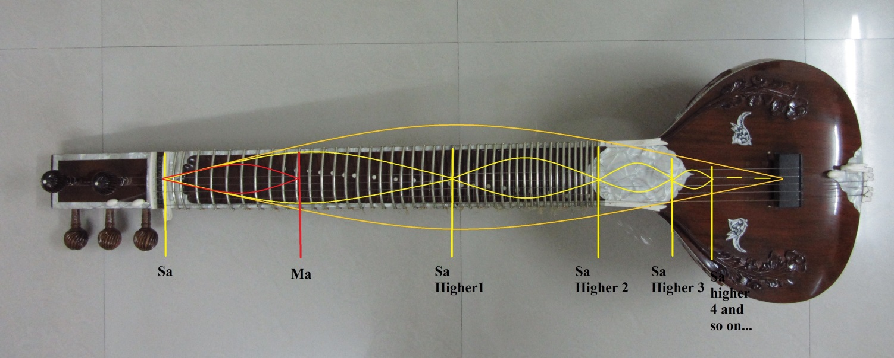
BHARAT VEENA:
A SYNTHESIS OF PHYSICS, MUSIC AND AESTHETICS
Madhyama swara is ¾ of a string and on the
mid-point between Shadja and the higher
Shadja swaras. That is the reason it is called
`Madhyama’ swara. It is a Harmonic Mean
of Shadja & Higher Shadja
- A Presentation by Dr. Vinod Vidwans

Slide 7
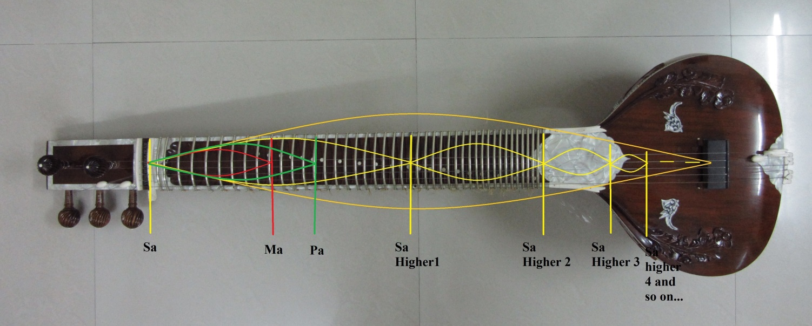
BHARAT VEENA:
A SYNTHESIS OF PHYSICS, MUSIC AND AESTHETICS
The Panchama swara is 2/3 of a string and
placed at the point having the ratio 1/3
between Shadja and the Higher Shadja.
Panchama is the Arithmetic Mean of
Shadja and Higher Shadja
- A Presentation by Dr. Vinod Vidwans

Slide 8
BHARAT VEENA:
A SYNTHESIS OF PHYSICS, MUSIC AND AESTHETICS
Shadja, Madhyama and Panchama give
birth to remaining Swaras and Shrutis.
This method is called `Chakriya Nyaya’
Sa-Ma ratio is known as Shadja-Madhyama Bhava
Sa-Pa ratio is known as Shadja-Panchama Bhava
- A Presentation by Dr. Vinod Vidwans

Slide 9
BHARAT VEENA:
A SYNTHESIS OF PHYSICS, MUSIC AND AESTHETICS
In ancient Greece this method was
known as the `Cycle of Fifth’
Sa-Ma ratio is known as the `Cycle of Fourth’
Sa-Pa ratio is known as the `Cycle of Fifth’
- A Presentation by Dr. Vinod Vidwans

Slide 10
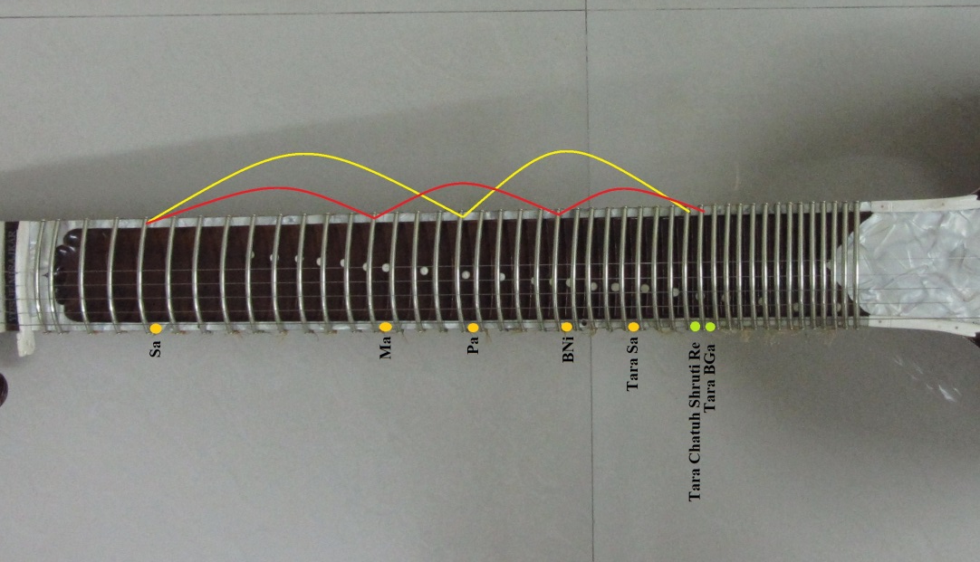
BHARAT VEENA:
A SYNTHESIS OF PHYSICS, MUSIC AND AESTHETICS
All the seven swaras and twenty two shrutis
can be generated by Chakriya Nyaya Method
as shown-
Shadja-Madhyama Bhava (Cycle of Fourth)
Shadja-Panchama Bhava (Cycle of Fifth)
- A Presentation by Dr. Vinod Vidwans

Slide 11
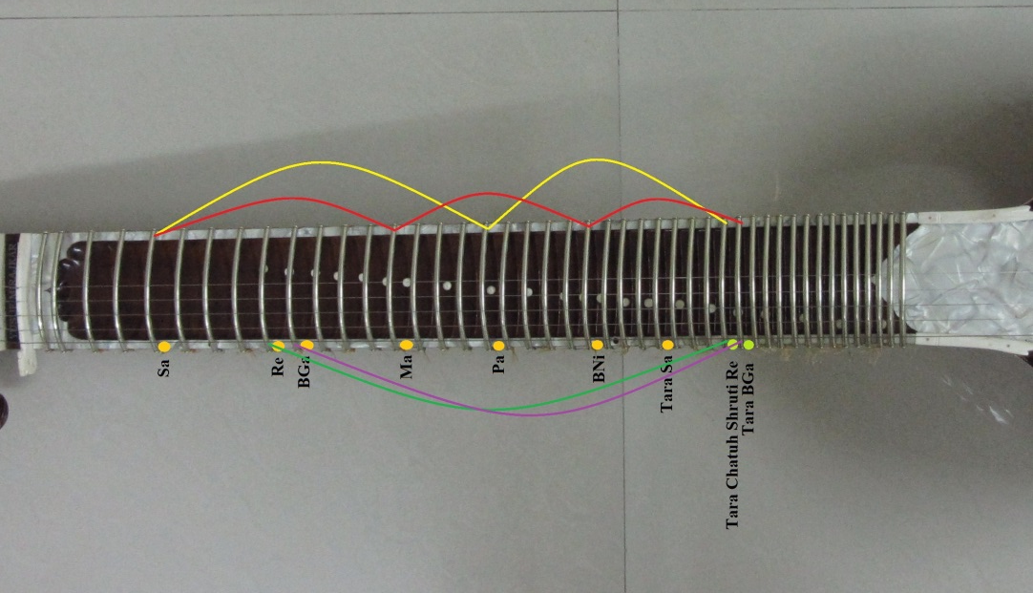
BHARAT VEENA:
A SYNTHESIS OF PHYSICS, MUSIC AND AESTHETICS
All the seven swaras and twenty two shrutis
can be generated by Chakriya Nyaya Method
as shown-
Shadja-Madhyama Bhava (Cycle of Fourth)
Shadja-Panchama Bhava (Cycle of Fifth)
- A Presentation by Dr. Vinod Vidwans

Slide 12
BHARAT VEENA:
A SYNTHESIS OF PHYSICS, MUSIC AND AESTHETICS
This method is also called
`Swara-Mandala Sadhanam’
अथद्वौ ग्रामौ षड्जग्रामो मध्यमग्रामश्चेति|
अत्राश्रिता द्वाविंशतिश्रुतयः स्वरमण्डलसाधिताः|
[Bharata’s Natyashastra]
- A Presentation by Dr. Vinod Vidwans

Slide 13
BHARAT VEENA:
A SYNTHESIS OF PHYSICS, MUSIC AND AESTHETICS
This method is also called
`Swara-Mandala Sadhanam’
तत एव स्थानान्तरे स्वरमंडलत्वमिति चक्रमुच्यते|
तच्च परिमंडलं आंगिरसकाश्यपादिभिः मुनिभिः दर्शितम् |
[Abhinavagupta in Bharata, p. 19].
- A Presentation by Dr. Vinod Vidwans

Slide 14
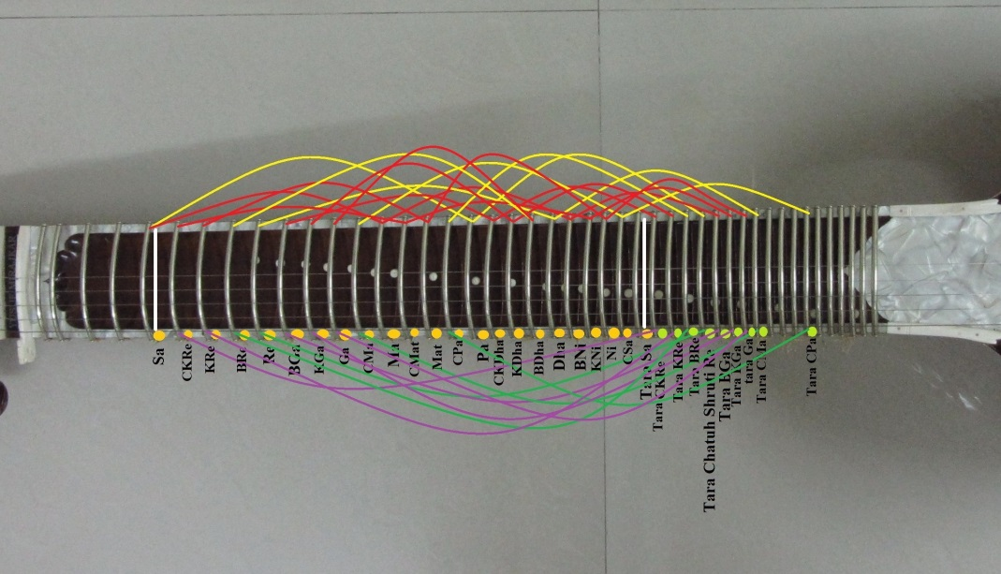
BHARAT VEENA:
A SYNTHESIS OF PHYSICS, MUSIC AND AESTHETICS
`Swara-Mandala Sadhanam’
This Method was known to the ancient sages
such as Aangirasa and Kashyapa. Abhinava Gupta
has described this method in his commentary on
Bharata’s Natyashastra.
- A Presentation by Dr. Vinod Vidwans

Slide 15
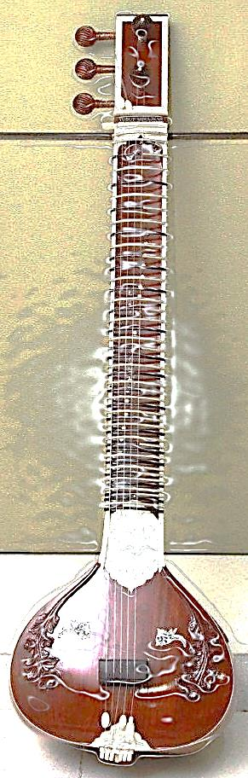
BHARAT VEENA:
A SYNTHESIS OF PHYSICS, MUSIC AND AESTHETICS
Ancient Greek and Indian cultures
Both were aware about the method of
`Swara-mandala Sadhanam’
in their own ways as discussed earlier. It was
known as the method of the `Cycle of Fifth’
- A Presentation by Dr. Vinod Vidwans

Slide 16
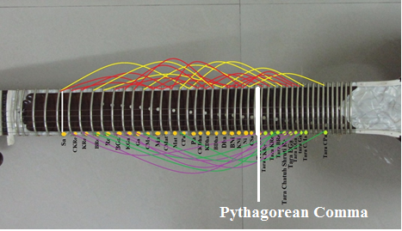
BHARAT VEENA:
A SYNTHESIS OF PHYSICS, MUSIC AND AESTHETICS
Pythagoras, a famous Mathematician
and Musician, attempted to generate
musical notes by applying the
method of the Cycle of Fifth and
The Cycle of Fourth
- A Presentation by Dr. Vinod Vidwans

Slide 17
BHARAT VEENA:
A SYNTHESIS OF PHYSICS, MUSIC AND AESTHETICS
In Pythagorean Mathematical Method,
Cycle of Fifth and The Cycle of Fourth
never converge to Higher Sa. This is
known as Pythagorean Comma(Error)
- A Presentation by Dr. Vinod Vidwans

Slide 18
BHARAT VEENA:
A SYNTHESIS OF PHYSICS, MUSIC AND AESTHETICS
Bharata’s Approach was experiential:
Cycle of Fifth and Fourth judged by
musical ear eliminates the
Pythagorean Comma (Error)
- A Presentation by Dr. Vinod Vidwans

Slide 19
BHARAT VEENA:
A SYNTHESIS OF PHYSICS, MUSIC AND AESTHETICS
Musical experience comprises of
physical tones & Subjective Tones
made of Aural Harmonics and
Combination Tones (Summation Tones
and Difference Tones together)
- A Presentation by Dr. Vinod Vidwans

Slide 20
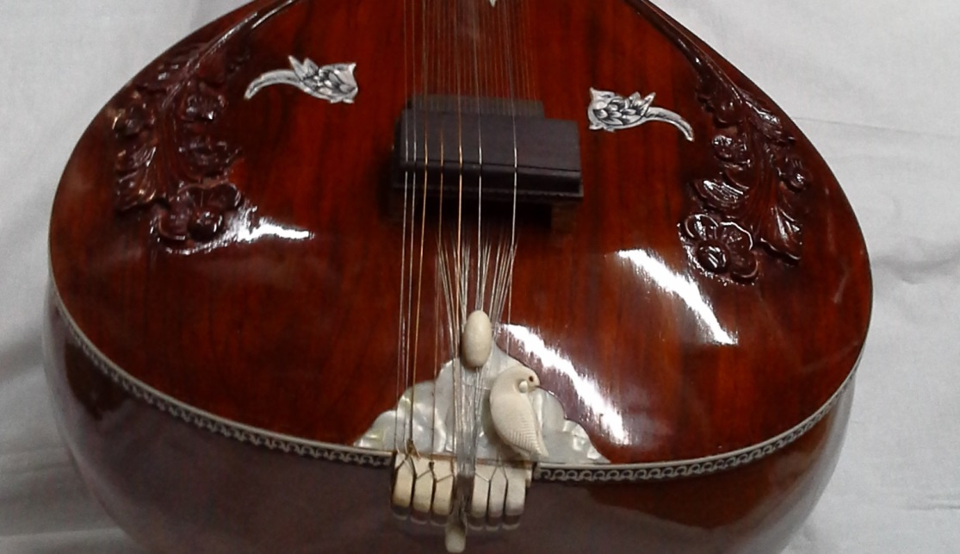
BHARAT VEENA:
A SYNTHESIS OF PHYSICS, MUSIC AND AESTHETICS
Musical experience is impacted by
micro-level shift of a string at the
bridge having characteristic Curvature.
It causes variation in frequencies
of Swaras and Shrutis
- A Presentation by Dr. Vinod Vidwans

Slide 21
BHARAT VEENA:
A SYNTHESIS OF PHYSICS, MUSIC AND AESTHETICS
Bharata’s Experiential Method leads
to perfect Twenty Two Shrutis
Pure Mathematical approach leads to
Pythagorean Comma & infinite regress
- A Presentation by Dr. Vinod Vidwans

Slide 22
BHARAT VEENA:
A SYNTHESIS OF PHYSICS, MUSIC AND AESTHETICS
Bharata’s Method leads to Equal
Temperament Twenty Two Shrutis.
The musical distance between any
two Shrutis is called Pramana Shruti
Pramana Shruti Ratio: 1.032
- A Presentation by Dr. Vinod Vidwans

Slide 23
BHARAT VEENA:
A SYNTHESIS OF PHYSICS, MUSIC AND AESTHETICS
S.N | Shruti Names | Swara Sequence | Swara Names | Ratio = Sa Freq. /Swara Frequency | Position on a 90 cm String
0 | Chhandovati | Sa | Shadja | 1 | 90 cm
0.5 |  | Ardha Shruti | Ardha-Shruti Shadja | 0.9844 | 88.596 cm
1 | Dayavati | Re 1 | Ati Komal Rishabha | 0.9689 | 87.201 cm
2 | Ranjani | Re 2 | Komal Rishabha | 0.9389 | 84.501 cm
3 | Raktika | Re 3 | Bharata’s Rishabha | 0.9098 | 81.882 cm
4 | Roudri | Re 4 | Chatuh-shruti Rishabha | 0.8816 | 79.334 cm
5 | Krodha | Ga 1 | Bharata’s Gandhara | 0.8542 | 76.878 cm
6 | Vajrika | Ga 2 | Sadharana Gandhara | 0.8277 | 74.493 cm
7 | Prasarini | Ga 3 | Aantar Gandhara | 0.8021 | 72.189 cm
8 | Priti | Ga 4 | Chyuta Madhyama | 0.7772 | 69.948 cm
9 | Marjani | Ma 1 | Madhyama | 0.7531 | 67.779 cm
10 | Kshiti | Ma 2 | Chyuta Teevra Madhyama | 0.7298 | 65.682 cm
11 | Rakta | Ma 3 | Teevra Madhyama | 0.7071 | 63.639 cm
12 | Sandipani | Ma 4 | Chyuta Panchama | 0.6852 | 61.668 cm
13 | Aalapini | Pa | Panchama | 0.6639 | 59.751 cm
14 | Madanti | Dha 1 | Ati Komal Dhaivata | 0.6434 | 57.906 cm
15 | Rohini | Dha 2 | Komal Dhaivata | 0.6234 | 56.106 cm
16 | Ramya | Dha 3 | Bharata’s Dhaivata | 0.6041 | 54.369 cm
17 | Ugra | Dha 4 | Chatuh-shruti Dhaivata | 0.5853 | 52.677 cm
18 | Kshobhini | Ni 1 | Bharata’s Nishada | 0.5672 | 51.048 cm
19 | Tivra | Ni 2 | Kaishiki Nishada | 0.5496 | 49.464 cm
20 | Kumudvati | Ni 3 | Kakali Nishada | 0.5326 | 47.934 cm
21 | Manda | Ni 4 | Chyuta Tara Shadja | 0.5157 | 46.413 cm
22 | Chhandovati | Taara Sa | Tara Shadja | 0.5000 | 45.00 cm
23 | Dayavati | Taara Re 1 | Taara Ati Komal Rishabha | 0.4844 | 43.596 cm
24 | Ranjani | Taara Re 2 | Taara Komal Rishabha | 0.4694 | 42.246 cm
25 | Raktika | Taara Re 3 | Taara Bharata’s Rishabha | 0.4549 | 40.941 cm
26 | Roudri | Taara Re 4 | Taara Chatuh-shruti Rishabha | 0.4408 | 39.672 cm
27 | Krodha | Taara Ga 1 | Taara Bharata’s Gandhara | 0.4271 | 38.439 cm
28 | Vajrika | Taara Ga 2 | Taara Sadharana Gandhara | 0.4138 | 37.242 cm
29 | Prasarini | Taara Ga 3 | Taara Aantar Gandhara | 0.4010 | 36.09 cm
30 | Priti | Taara Ga 4 | Chyuta Madhyama | 0.3886 | 34.974 cm
31 | Marjani | Taara Ma 1 | Taara Madhyama | 0.3765 | 33.885 cm
32 | Kshiti | Taara Ma 2 | Taara Chyuta Teevra Madhyama | 0.3648 | 32.832 cm
33 | Rakta | Taara Ma 3 | Taara Teevra Madhyama | 0.3535 | 31.815 cm
34 | Sandipani | Taara Ma 4 | Chyuta Panchama | 0.3426 | 30.834 cm
35 | Aalapini | Taara Pa | Taara Panchama | 0.3320 | 29.88 cm
36 | Madanti | Taara Dha 1 | Taara Ati Komal Dhaivata | 0.3217 | 28.953 cm
37 | Rohini | Taara Dha 2 | Taara Komal Dhaivata | 0.3117 | 28.053 cm
38 | Ramya | Taara Dha 3 | Taara Bharata’s Dhaivata | 0.3021 | 27.189 cm
39 | Ugra | Taara Dha 4 | Taara Chatuh-shruti Dhaivata | 0.2927 | 26.343 cm
40 | Kshobhini | Taara Ni 1 | Taara Bharata’s Nishada | 0.2836 | 25.524 cm
41 | Tivra | Taara Ni 2 | Taara Kaishiki Nishada | 0.2748 | 24.732 cm
42 | Kumudvati | Taara Ni 3 | Taara Kakali Nishada | 0.2663 | 23.967 cm
43 | Manda | Taara Ni 4 | Taara Chyuta Tara Shadja | 0.2580 | 23.22 cm
44 | Chhandovati | Ati Taara Sa | Ati Tara Shadja | 0.2500 | 22.5 cm
Pramana Shruti Ratio: 1.032
All 22 Shrutis are established on the
Bharat Veena by following this Ratio
- A Presentation by Dr. Vinod Vidwans

Slide 24
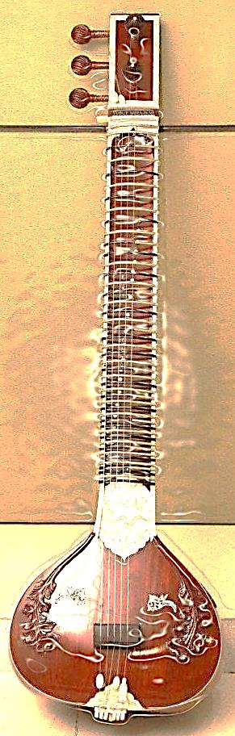
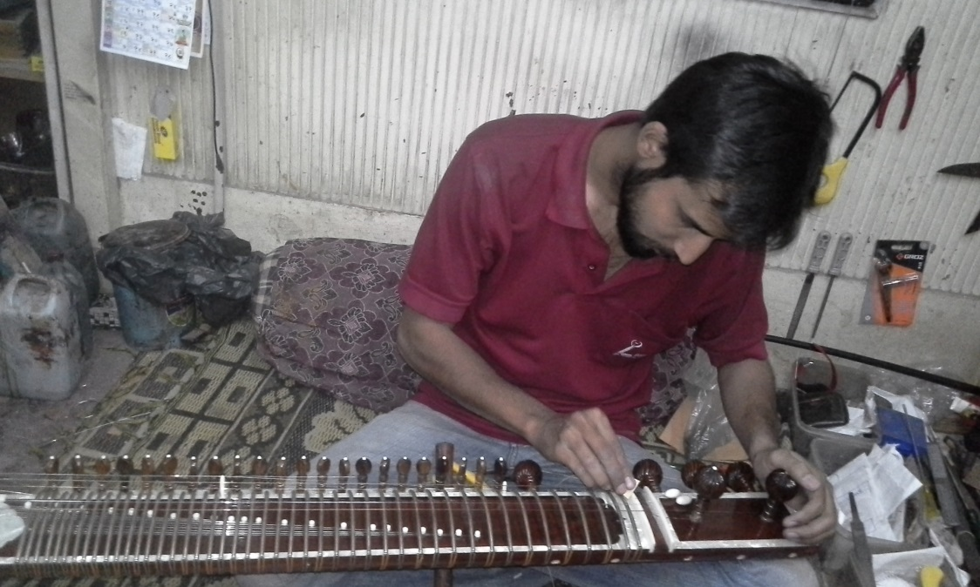
BHARAT VEENA:
A SYNTHESIS OF PHYSICS, MUSIC AND AESTHETICS
All the frets of Bharat Veena are fixed
by following Pramana Shruti Ratio.
(Mr. Matin Mirajkar at work)
- A Presentation by Dr. Vinod Vidwans

Slide 25
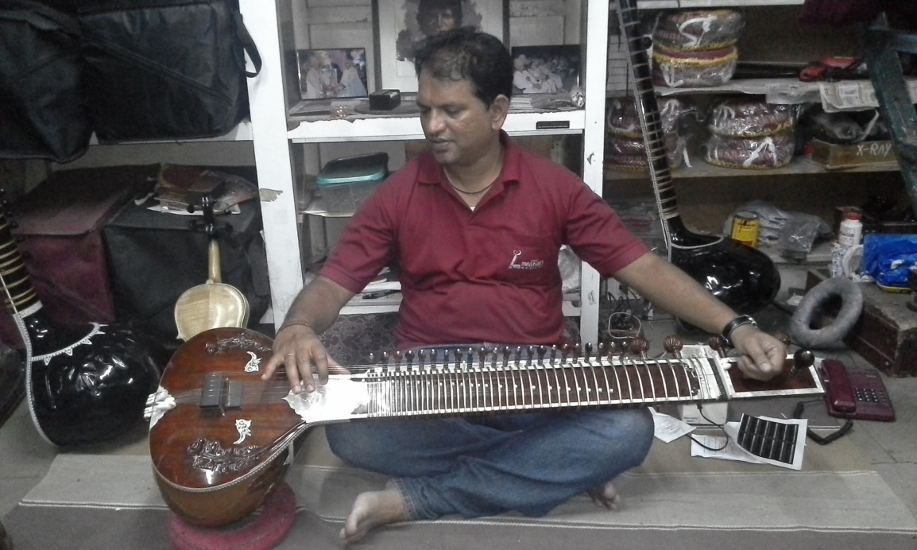
BHARAT VEENA:
A SYNTHESIS OF PHYSICS, MUSIC AND AESTHETICS
There are Twenty Two frets in each
Saptaka dedicated to each shruti.
(Mr. Sajid Mirajkar checking the Shrutis)
- A Presentation by Dr. Vinod Vidwans

Slide 26
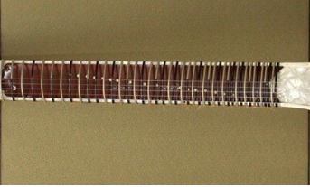
BHARAT VEENA:
A SYNTHESIS OF PHYSICS, MUSIC AND AESTHETICS
All the frets are Color Coded to
distinguish varieties of Shrutis and
Swaras.
- A Presentation by Dr. Vinod Vidwans

Slide 27
BHARAT VEENA:
A SYNTHESIS OF PHYSICS, MUSIC AND AESTHETICS
Thus Bharat Veena is Designed and
Developed based on the study of
Bharata’s Natyashastra and
Sangita Ratnakara of Sharangadeva
- A Presentation by Dr. Vinod Vidwans

Slide 28
BHARAT VEENA:
A SYNTHESIS OF PHYSICS, MUSIC AND AESTHETICS
Bharat Veena is capable of
demonstrating the ancient Musical
Theoretical Concepts such as
Shruti Nidarshanam Experiment from
Bharata’s Natyashastra
- A Presentation by Dr. Vinod Vidwans

Slide 29
BHARAT VEENA:
A SYNTHESIS OF PHYSICS, MUSIC AND AESTHETICS
With the help of Shruti Nidarshanam
experiment we can generate twenty
two shrutis as well as verify the
accuracy of Shrutis. It provides a
Generative & Confirmative Proof .
- A Presentation by Dr. Vinod Vidwans

Slide 30
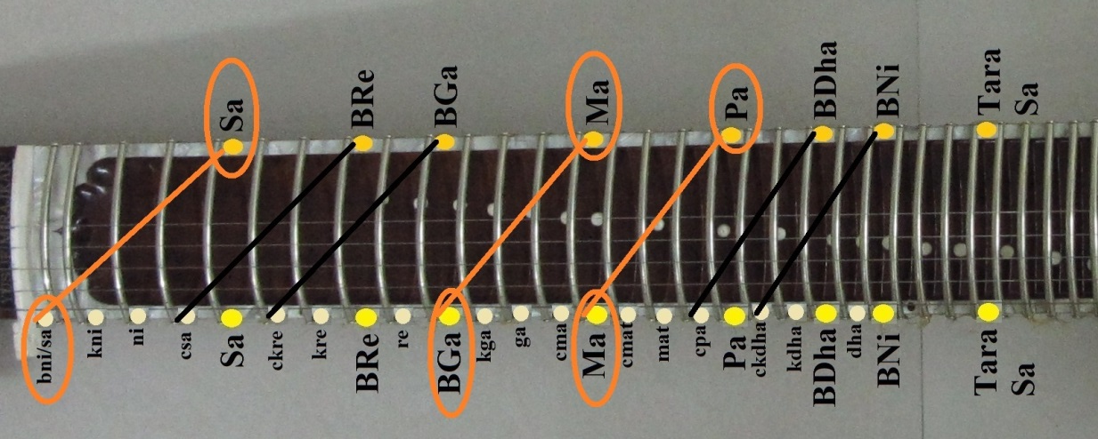
BHARAT VEENA:
A SYNTHESIS OF PHYSICS, MUSIC AND AESTHETICS
Shruti Nidarshanam Experiment
is also known as `Sarana-Chatushtayi
Prayoga’. It can be performed on the
Bharat Veena.
- A Presentation by Dr. Vinod Vidwans

Slide 31
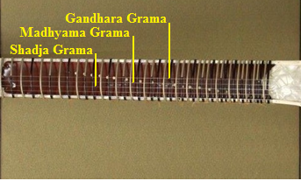
BHARAT VEENA:
A SYNTHESIS OF PHYSICS, MUSIC AND AESTHETICS
Bharat Veena:
Bharat Veena has dedicated Strings
for Shadja Grama, Madhyama Grama
and Gandhara Grama each
- A Presentation by Dr. Vinod Vidwans

Slide 32
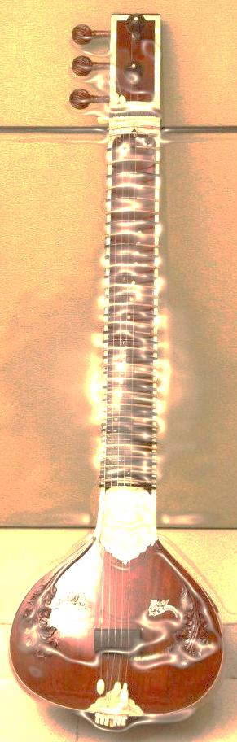
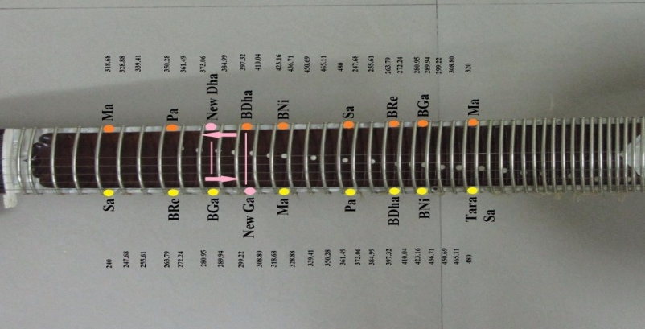
BHARAT VEENA:
A SYNTHESIS OF PHYSICS, MUSIC AND AESTHETICS
Bharat Veena:
Gramantara Experiment can be
shown on Bharat Veena. It is also
a confirmatory proof of 22 Shrutis.
- A Presentation by Dr. Vinod Vidwans

Slide 33
BHARAT VEENA:
A SYNTHESIS OF PHYSICS, MUSIC AND AESTHETICS
Four Shruti-Flavors of Rishabha and
Dhaivata …
Three Shruti-Flavors of Gandhara and
Nishada …
Two Shruti-Flavors of Shadja, Madhyama
and Panchama …
All can be demonstrated on the
Bharata Veena
- A Presentation by Dr. Vinod Vidwans

Slide 34
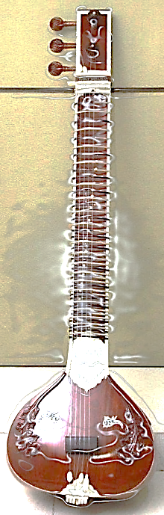
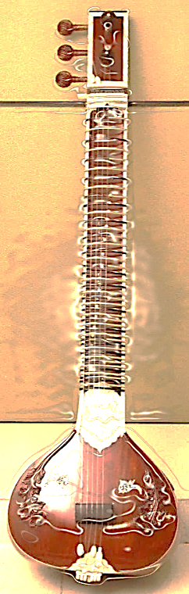
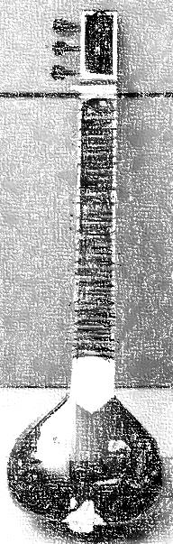
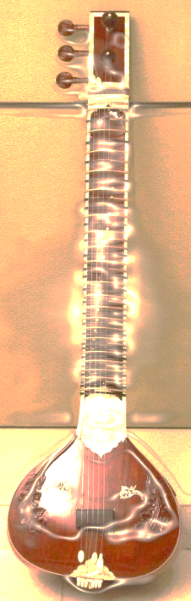
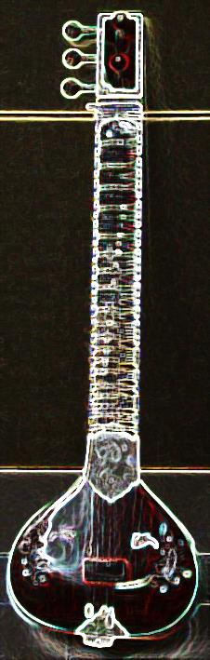
BHARAT VEENA:
A SYNTHESIS OF PHYSICS, MUSIC AND AESTHETICS
Bharat Veena:
There are many more interesting
musical features of Bharata Veena
relevant for Contemporary Music too
- A Presentation by Dr. Vinod Vidwans

Slide 35
BHARAT VEENA:
A SYNTHESIS OF PHYSICS, MUSIC AND AESTHETICS
Thanks!
- A Presentation by Dr. Vinod Vidwans

