Slide 1
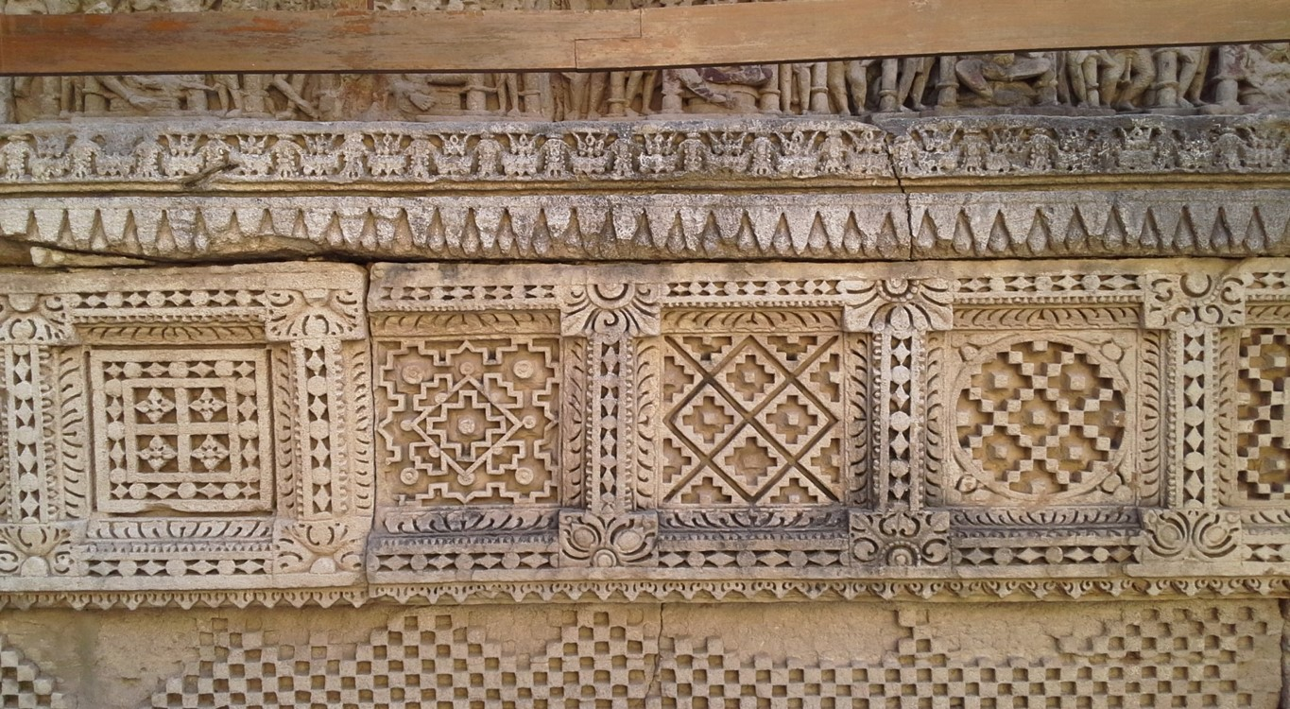
Computational Musicology: Algorithms Meet Aalaps
Algorithms Meet Aalaps
Dr. Vinod Vidwans
Professor
Department of Design, Art and Performance,
FLAME University, Pune

Slide 2
Computational Musicology
Digital Humanities
Digital humanities is an interdisciplinary field at the intersections of the humanities and computational methods/information technologies.
Scholars engaging with digital humanities use the powers of computational systems to approach humanistic inquiry in new ways.
Digital humanities work applies quantitative methods to qualitative research.
Algorithms Meet Aalaps

Slide 3
Computational Musicology
Prospects in Digital Humanities
The future of Digital Humanities is bright, holding the promise of profound transformation in humanities research and beyond.
Enhanced Research Capabilities: Computational tools allow scholars to analyse vast collections of cultural artifacts and texts (Big Data) in ways that were previously impossible leading to new discoveries and research questions.
Algorithms Meet Aalaps

Slide 4
Computational Musicology
Prospects in Digital Humanities
Increased Accessibility and Democratization: Digitization and the creation of open-access archives significantly democratize knowledge, making historical, literary, and cultural materials available to a global audience, regardless of physical location.
https://www.indiandistricts.in
FLAME University, Pune initiative.
Algorithms Meet Aalaps

Slide 5
Computational Musicology
Prospects in Digital Humanities
Interdisciplinary and Collaborative Innovation: Digital Humanities is inherently transdisciplinary, fostering collaboration among humanists, computer scientists, linguists, librarians, and data analysts.
This team-based approach leads to the development of sophisticated new methods and tools.
Algorithms Meet Aalaps

Slide 6
Computational Musicology
Prospects in Digital Humanities
Integration of Emerging Technologies: The field is actively engaging with cutting-edge technologies like Artificial Intelligence (AI) and Machine Learning (ML) for tasks like text restoration and advanced text analysis.
Computational Interpretation of Pāṇini’s Aṣṭādhyāyi.
Algorithms Meet Aalaps

Slide 7
Computational Musicology
Prospects in Digital Humanities
Algorithms Meet Aalaps
https://www.academia.edu/143612425/Machine_interpreting_P%C4%81%E1%B9%87inis_A%E1%B9%A3%E1%B9%AD%C4%81dhy%C4%81y%C4%AB_A_Feasibility_Study_with_K%E1%B9%9Bdanta_Word_Generation_in_Sa%E1%B9%83sk%E1%B9%9Bt

Slide 8
Computational Musicology
Prospects in Digital Humanities
Integration of Immersive Technologies: Immersive technologies like Virtual Reality (VR) and 3D Modelling are transforming cultural heritage preservation and public engagement (e.g., virtual museums).
Algorithms Meet Aalaps
vmis.in
VMIS - VIRTUAL MUSEUM OF IMAGES AND SOUNDS

Slide 9
Computational Musicology
Prospects in Digital Humanities
Workforce Readiness and Public Impact: Digital Humanities programs equip students with a valuable blend of critical thinking (a core humanities skill) and technical/data literacy (highly sought-after in the modern workforce).
Digital Humanity professionals need to acquire computational technology skills.
Algorithms Meet Aalaps

Slide 10
Computational Musicology
Practical Applications
AI has found profound applications across the Digital Humanities, challenging and augmenting human creativity.
Literature and Narrative Generation,
Story Generation, Poetry Generation, Visual Arts and
Design, Style Transfer, Autonomous Generation,
Architectural Design and so on…
Algorithms Meet Aalaps

Slide 11
Computational Musicology
Developing Humanistic Systems
Digital Humanities is a multi-disciplinary field at the intersection of Artificial Intelligence (AI), cognitive psychology, philosophy, and the arts.
It is the study and practice of constructing computational systems that exhibit behaviours, which would be deemed humane.
Algorithms Meet Aalaps

Slide 12
Computational Musicology
Developing Humanistic Systems
Replication: To build a computer program capable of human-level, or even superhuman, creativity, generating artifacts that are novel, high-quality, and surprising.
This should be the broader agenda of Digital Humanities.
Algorithms Meet Aalaps

Slide 13
Computational Musicology
Developing Humanistic Systems
Simulation: To better understand the human behavioural processes by modelling it algorithmically.
Enhancement (Co-Creativity): To develop tools that actively collaborate with and amplify human analytical ability, leading to mixed-initiative systems where both human and machines contribute to the creative act.
Algorithms Meet Aalaps

Slide 14
Computational Musicology
Milestones in Humanistic Systems
AARON (1973–Present)
Created by artist Harold Cohen, AARON is a seminal, rule-based system that autonomously generated thousands of original drawings and paintings. It used a knowledge-based approach to simulate the artist's conceptual understanding of human figures, space, and colour.
Algorithms Meet Aalaps

Slide 15
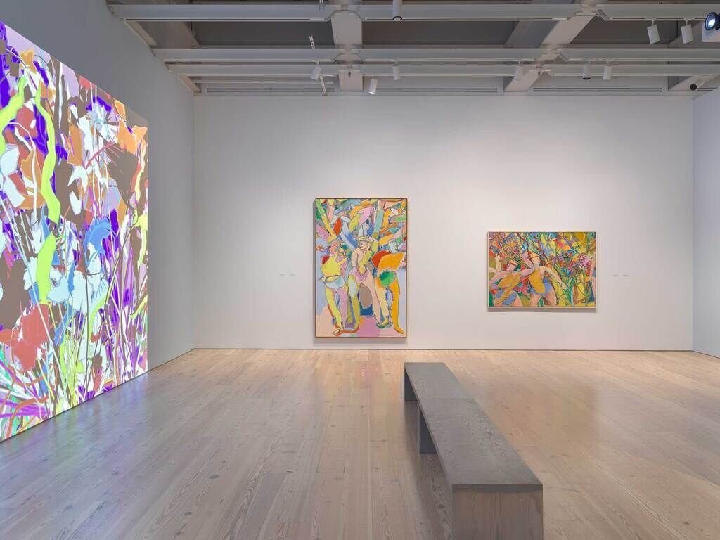
Computational Musicology
AARON (1973–Present)
Algorithms Meet Aalaps

Slide 16
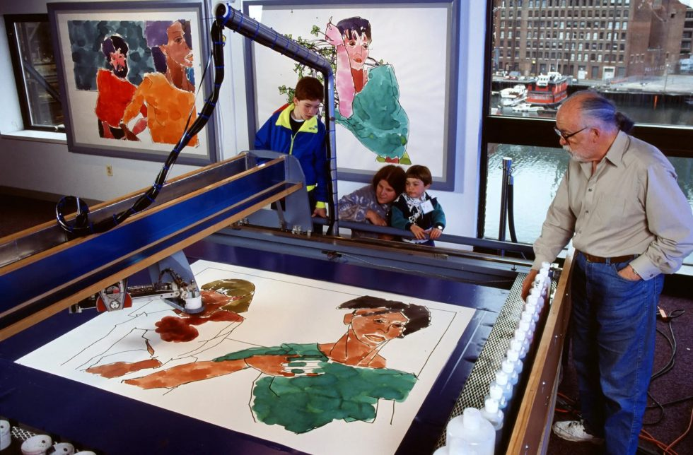
Computational Musicology
AARON (1973–Present)
Algorithms Meet Aalaps

Slide 17
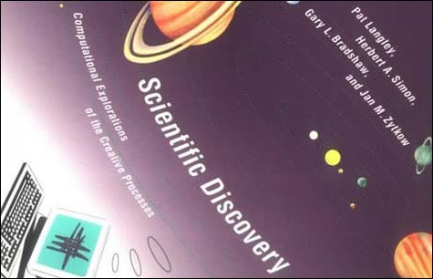
Computational Musicology
BACON (1980s)
An AI program by Langley's group that rediscovered several fundamental scientific laws (e.g., Kepler's Third Law),—an early example of exploratory creativity in science.
Algorithms Meet Aalaps

Slide 18
Computational Musicology
Deep Learning Revolution (GANs/Transformers) 2010-present
The advent of deep learning, particularly Generative Adversarial Networks (GANs) and Transformer models (like GPT and DALL-E), dramatically increased the quality and novelty of generated artifacts, leading to the “Generative AI" boom.
Algorithms Meet Aalaps

Slide 19
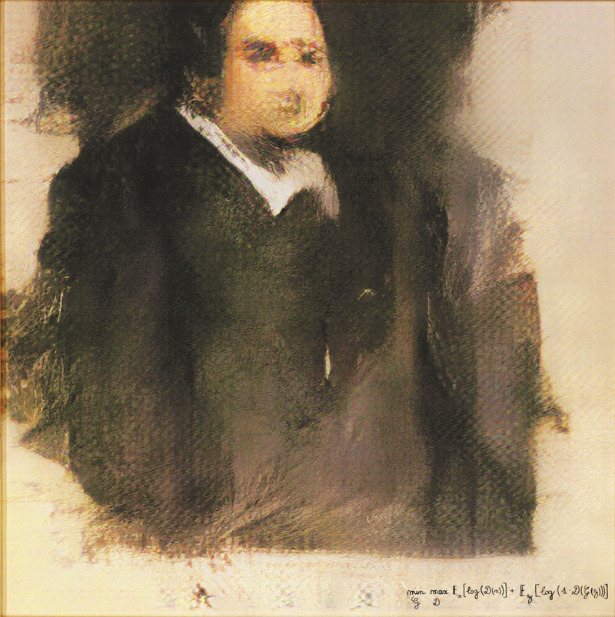
Computational Musicology
The artwork Portrait of Edmond de Belamy, which was generated by a GAN and sold for US$ 432,500 at a major auction house.
Algorithms Meet Aalaps

Slide 20
Computational Musicology
DeepMind's AlphaGo Zero (2017)
Though for a game, its self-taught, superhuman moves were heralded as moments of "true creativity" by observers, showcasing transformational creativity by transcending human-established conceptual boundaries.
Algorithms Meet Aalaps

Slide 21
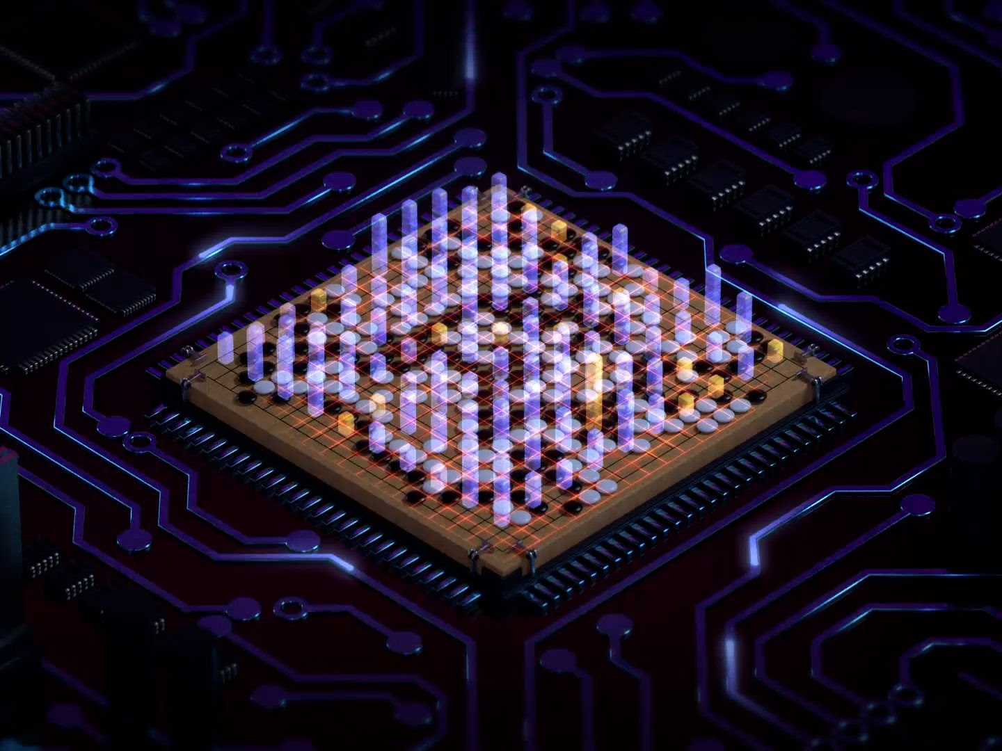
Computational Musicology
DeepMind's AlphaGo Zero (2017)
Algorithms Meet Aalaps

Slide 22
Computational Musicology
Computational Musicology and Digital Humanities
Computational Musicology is a sub-field that integrates the study of music with computational methods, making it a natural and vital component of Digital Humanities.
It applies data science, artificial intelligence (AI), and advanced computing tools to analyse, represent, and understand music in ways traditional musicology cannot.
Algorithms Meet Aalaps

Slide 23
Computational Musicology
Computational Musicology and Digital Humanities
Music Information Retrieval (MIR): This is the heart of the field. It focuses on developing systems to search, analyse, and manage digital music data.
Tasks include automatic genre classification, identifying a piece of music based on a hummed melody, or finding structural patterns in large musical archives.
Algorithms Meet Aalaps

Slide 24
Computational Musicology
Computational Musicology and Digital Humanities
Digital Music Encoding and Analysis: Scholars use standardized formats like MusicXML or MEI (Music Encoding Initiative) to represent musical scores in a machine-readable format. This allows for computational analysis of features like:
Style, Harmony, Rhythm, Meter, Performance Analysis
Algorithms Meet Aalaps

Slide 25
Computational Musicology
Computational Musicology and Digital Humanities
Corpus Creation and Visualization: Computational musicologists create massive digital collections, or corpora, of musical data (scores, audio, and metadata). They then use data visualization techniques to map out stylistic trends, composer networks, or the geographic spread of musical forms.
Music in Motion by NCPA Mumbai- website: https://autrimncpa.wordpress.com/
Algorithms Meet Aalaps

Slide 26
Computational Musicology
Computational Musicology and Digital Humanities
By treating music as complex, structured data, computational musicology not only aids in the study of music history but also contributes to the broader mission of developing new knowledge through computational engagement with human culture.
Algorithms Meet Aalaps

Slide 27
Computational Musicology
Computational Musicology and Digital Humanities
Music is “Organized Sound”, Composers add patterns of
ordered variations in pitch, timing and other parameters.
This brings in musical expressiveness.
Algorithms Meet Aalaps

Slide 28
Computational Musicology
Computational Musicology and Digital Humanities
Music Composition has always been guided by Musician’s
own `Computational Thinking’ though
Inspiration may play some role.
Formalization of Musical Principles through computers and Artificial Intelligence (AI) is just a next step forward.
Algorithms Meet Aalaps

Slide 29
Computational Musicology
Computational Musicology and Digital Humanities
AI-Music involves many Computational Strategies for Computers, Robotics and all the Future Technologies.
Generative Grammars,
Knowledge-Based Systems,
Markov Chains and Artificial Neural Networks,
Evolutionary and Genetic Algorithms,
Self-Similarity and Cellular Automata etc.
Algorithms Meet Aalaps

Slide 30
Computational Musicology
Examples of Computational Models
Machine Learning ANN Music - Demo
FUGUE MACHINE - Demo
Musical fractal - Demo
Cellular Automaton - Demo
Algorithms Meet Aalaps

Slide 31
Computational Musicology
Computational Musicology for India
The established Gyāna-Samvid (compendium of expertise) for Indian music can be documented and preserved as ‘smart’ digital repositories, ‘smart’ books, and ‘smart’ systems.
A significant amount of work has already been undertaken in Sanskrit grammar, based on Pāṇini’s Aṣṭādhyāyi.
Algorithms Meet Aalaps

Slide 32
Computational Musicology
Computational Musicology for India
In this context, Artificially Intelligent Expert Systems for Indian Music called ‘Bhārati’, ‘AI-Tāla’, and ‘AI-Rāga’ have been designed and developed by the author of this presentation.
These innovative systems are based mainly on the 28th Chapter of Bharata’s Nāṭyaśāstra, known as ‘Sangītādhyāya’.
Algorithms Meet Aalaps

Slide 33
Computational Musicology
The Bhārati System
The primary objective of the Bhārati system is to substantiate that the theoretical constructs derived from the Nāṭyaśāstra and the Sangīta Ratnākara are axiomatically structured, permitting the computational simulation of all Sūtras for the digital preservation of this knowledge corpus.
Algorithms Meet Aalaps

Slide 34
Computational Musicology
The Bhārati System
This innovative system encapsulates core concepts such as Bharata’s swaras and Śrutis, Ṣaḍja Grāma, Madhyama Grāma, various types of Gandhāra Grāma, Shuddha Mūrcchanās, Sāntarā Mūrcchanās, Sakākali Mūrcchanās, and Ubhaya Mūrcchanās etc.
Algorithms Meet Aalaps

Slide 35
Computational Musicology
The Bhārati System
Bhārati System Demonstration.
Algorithms Meet Aalaps

Slide 36
Computational Musicology
AI-Tala
The AI-Tāla Expert System integrates knowledge of Druta Laya, Madhya Laya, and Vilambita Laya, as well as Hindusthani and Carnatic Tālas.
It can generate and render a solo Tabla composition of 10 to 15 minutes utilizing these forms.
Algorithms Meet Aalaps

Slide 37

Computational Musicology
AI-Tala
Algorithms Meet Aalaps

Slide 38
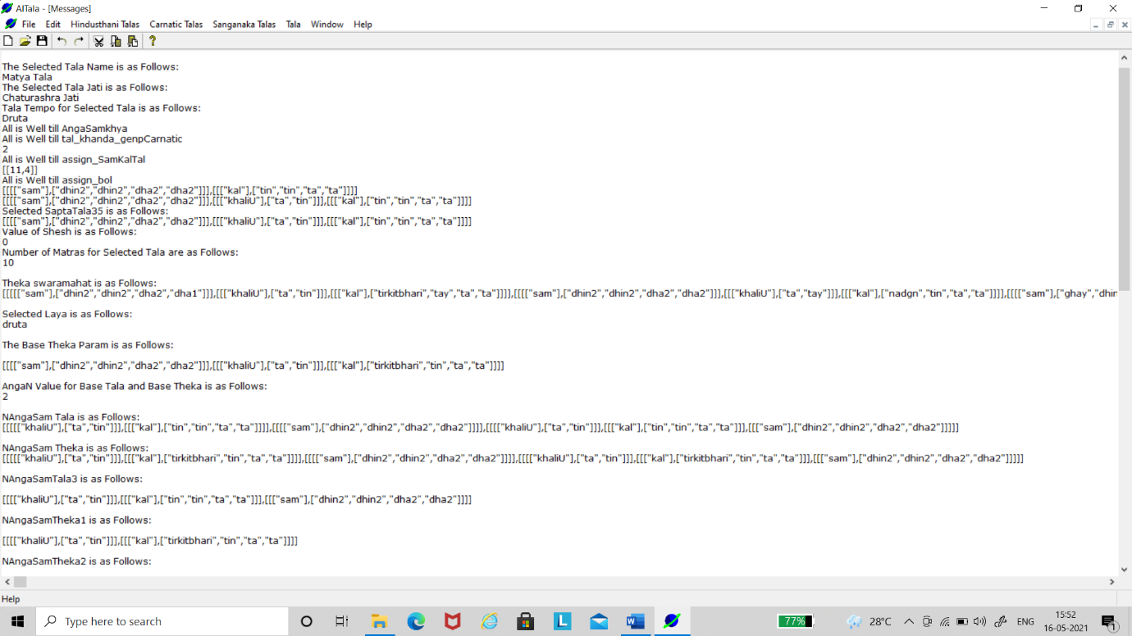
Computational Musicology
AI-Tala
Algorithms Meet Aalaps

Slide 39
Computational Musicology
AI-Tala
AI-Tala Example.
Algorithms Meet Aalaps

Slide 40
Computational Musicology
The AI-Rāga System
The primary goal of AI-Rāga is to validate AI's capability for simulating the Rāgas of Indian Music. In this context, AI traverses the domain of human creativity through the automated composition of Gat/Bandiś.
Algorithms Meet Aalaps

Slide 41
Computational Musicology
The AI-Rāga System
This architecture integrates the knowledge constructs of the aforementioned systems, Bhārati and AI-Tāla.
The composition (Bandiś) is acoustically rendered using artificial instruments, complemented by a simulated Tabla accompaniment.
Algorithms Meet Aalaps

Slide 42
Computational Musicology
The AI-Rāga System
Demonstration of the AI-Raga System
https://computationalmusic.com
Algorithms Meet Aalaps

Slide 43
Computational Musicology
Conclusion and Future Directions
Computational Musicology is not just about building creative machines; it is a powerful tool for holding a mirror up to human consciousness, forcing us to ask: If a machine can mimic our creative acts, what truly makes our creativity unique? The answer will define the next great frontiers of both ‘Digital Humanity’ and the ‘Human Experience’.
Algorithms Meet Aalaps

Slide 44
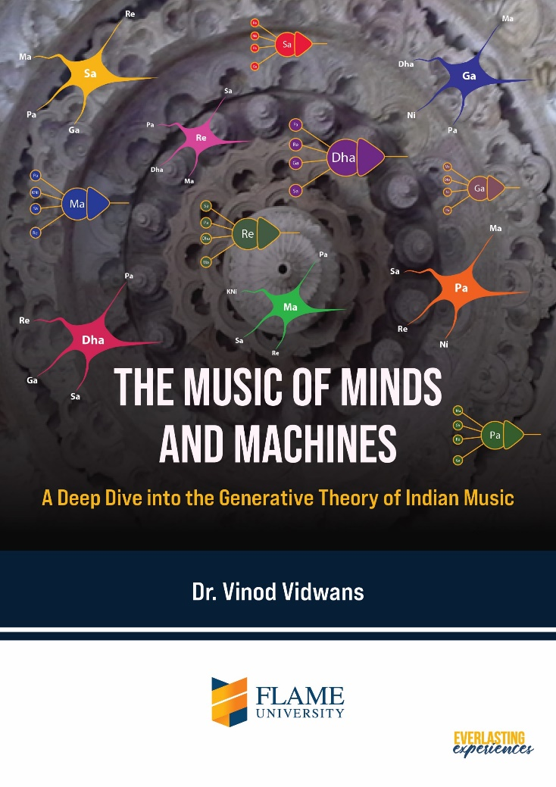
Computational Musicology
Algorithms Meet Aalaps
https://computationalmusic.com/pdfs/The-Music-of-Minds-and-Machines.pdf

Slide 45
Computational Musicology
Algorithms Meet Aalaps
Thanks!

